Slide 1
Chapter Five
Architecture In The Life Cycle

Slide 2
Architecture in the agile projects
Architecture is the blueprint that defines the structure, relationships, and principles of a system within its environment.
Grady Booch aptly stated, “All architecture is design but not all design is architecture.”
It embodies the significant design decisions that shape a system, often defined by the difficulty of change.
This leads to Martin Fowler’s insightful observation that architecture is often defined by what is perceived as “hard to change.”

Slide 3
Cont…
Agile methodology, on the other hand, is a philosophy that values flexibility and responsiveness.
It empowers self-organizing teams, promoting incremental development and frequent iterations.
Agile recognizes that change is expectable and embraces it as a natural part of the development process.
The marriage of architecture and agility can be confusing.
Agile emphasizes ease of change, while architecture typically encapsulates elements that are hard to alter.

Slide 4
Cont…
An effective software architect acts as a city planner, creating a dynamic blueprint that allows for growth and change without forgoing coherence.
Software architecture spans various levels, from code-level design to enterprise-wide structures.
Each tier influences the system’s qualities, such as performance, scalability, and security.

Slide 5
Agile’s Influence on Architecture
Agile methodology promotes collaboration, iterative development, and a focus on working software.
Architectural decisions align with the Agile attitude by favoring adaptability, responding to change, and promoting transparency.
Agile architects embrace “just-in-time” architecture, where solutions evolve iteratively in response to the dynamic nature of software development.

Slide 6
Role of the Architect in Agile
In an Agile environment, the architect evolves from being a mere designer to a technical leader who provides vision, guidance, and design principles.
architects facilitate discussions, mentor developers, and ensure technical alignment.
The architect’s involvement in actual code writing contributes to a better understanding of implementation challenges.
Agile development methods have been designed to solve the problem of delivering high quality software on time under constantly and rapidly changing requirements and business environments.
a software architect requires a wide range of both general and technical skills.

Slide 7
Cont..
The software architect must also possess the technical skills required to understand how modern software systems, frames, and hardware support the requirements; how network and operating system factors can affect design decisions; and how trends and changes in these areas will have an impact on design.
After the initial requirements analysis, the software architect must also apply his technical skills around design patterns, communication and messaging standards, code capabilities, security issues and performance constraints. All of these require in-depth knowledge of the technologies that will be used to implement the final software.
To do this modern architects need to master UML, especially if they plan to use new technologies and especially those oriented to objects.

Slide 8
Principles of Agile
The methods introduced each require assembling relevant
The goal of agile methods is to allow an organization to be agile, but what does it mean to be Agile. Agile means being able to “Deliver quickly”; “Change quickly and often”
Agile techniques vary in practices and emphasis, they follow the same principles behind the agile manifesto
Working software is delivered frequently (weeks rather than months).
Working software is the principal measure of progress.
Customer satisfaction by rapid, continuous delivery of useful software.
Late changes in software requirements are accepted.
Close daily cooperation between business people and software developers.
Face-to-face conversation is the best form of communication.
Projects are built around motivated individuals who should be trusted.
Continuous attention to technical excellence and good design.

Slide 9
Architecture and requirements
The software architecture process takes clients’ requirements, analyzes them and produces a design to obtain software that will satisfy their needs.
Software architecture means defining a structured solution that meets all technical and operational requirements and, at the same time, optimizing common attributes of quality such as performance, security and manageability.

Slide 10
Designing and documentation
The design phase of software development deals with transforming the customer requirements as described in the SRS documents into a form implementable using a programming language.
The software design process can be divided into the following three levels of phases design:
Interface Design
Architectural Design
Detailed Design

Slide 11
Cont…
Software Design Document is a written document that provides a description of a software product in terms of architecture of software with various components with specified functionality.
These design documents are written by software engineers/designers or project managers and further passed to the software development team to give them an overview of what needs to be built and how.

Slide 12
S.No | Software Design Document | Module, Subpart
01 | Reference Documents | 1. Existing software documentation 2. System Documentation 3. Vendor(hardware or software) documents 4. Technical reference
02 | Modules for each module | 1. Processing narrative 2. Interface description 3. Design language(or other) description 4. Modules used
03 | Scope | 1. System objective 2. Hardware, software and human interfaces 3. Major software functions 4. Externally defined database 5. Major design constraints, limitations
04 | Design Description | 1. Data description 2. Derived program structure 3. Interface within structure
05 | Test Provisions | 1. Test guidelines 2. Integration strategy 3. Special considerations

Slide 13
S.No | Software Design Document | Module, Subpart
06 | Packaging | 1. Special program overlay provisions 2. Transfer consideration
07 | File Structure and global data | 1. External Files structure 2. Global data 3. File and data cross – reference
08 | Requirement cross-reference | 1. cross-reference

Slide 14
Importance of Design Documentation:
Requirements are well understood: With proper documentation, we can remove inconsistencies and conflicts about the requirements. Requirements are well understood by every team member.
Architecture/Design of product: Architecture/Design documents give us a complete overview of how the product look like and better insight to the customer/user about their product.
New Person can also work on the project: New person to the project can very easily understand the project through documentations and start working on it.

Slide 15
Cont…
4. Everything is well Stated: This documentation is helpful to understand each and every working of the product. It explains each and every feature of the product/software.
5. Proper Communication: Through documentation, we have good communication with every member who is part of the project/software. Helpful in understanding role and contribution of each and every member.

Slide 16
Implementation and testing
Implementation is the process of:
defining how the information system should be built (i.e., physical system design),
ensuring that the information system is operational and used,
ensuring that the information system meets quality standard (i.e., quality assurance).
Testing process
Program testing with test data
Link testing with test data
Full systems testing with test data
Full systems testing with live data

Slide 17
Cont…
Testing guidelines
Test different aspects of the system, e.g., response time, response to boundary data, response to no input, response to heavy volumes of input
Test anything that could go wrong or be wrong about a system
Test the most frequently used parts of the system at a minimum
The people who create the test cases should not be the same people as those who coded and tested the system
Use debugging tools, e.g., symbolic debugger

Slide 18
Cont…
7 types of tests
Test | Description | Characteristic
Inspection | Manually examine code for errors | Detect 60 to 90 percent of defects
Walkthrough | Manually review code to find errors by examining what the code does | Should be done when the pieces of work are small
Desk checking | Manually work through the code, executing each instruction using test cases | The reviewer acts as a algorithm
Syntax checking | Uncover syntax errors by a compiler, used to examine the format and the gramma | The only automated testing technique that is static
Unit/module testing | Discover any error that may exist in a module's code | Each module is tested alone
Integration testing | Discover any error that may exist by combining modules | Top-down gradual testing
System testing | Discover any error that may exist by integrating programs into systems | Top-down gradual testing

Slide 19
Architecture reconstruction and conformance
Architecture reconstruction:
is an “as-built” architecture of an implemented of system i.e obtained from the existing system
It is done through the “detail analysis ” of the system, using tool support.
, If the tools are successful, the end result is an architectural representation.
Although it is not an automatic process
It is an “interpretive ”, “interactive” and “iterative” process involving many activities.
Requires the skills and attention of both the engineering expert and the architect

Slide 20
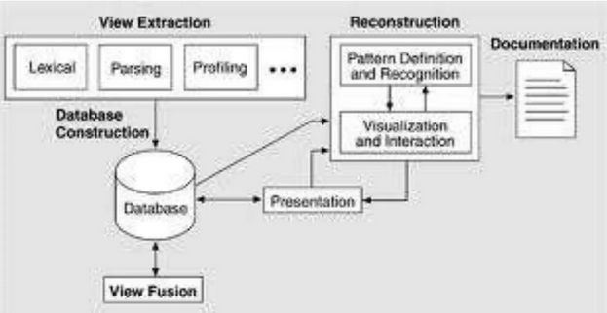
Reconstruction Activities
Software Architecture reconstruction comprise the following activities, carried out iteratively:-
Information Extraction
Database Construction
View Fusion
Reconstruction
Figure: ArchitectureReconstruction Activities

Slide 21
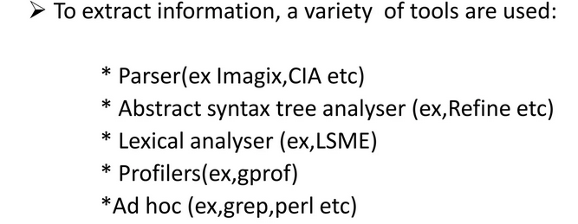
Information Extraction
The purpose of this activity is to extract information from various Sources .

Slide 22
Database Construction
Database construction involves converting information into a standard form, such as Rigi(Receiving Inspection General Instruction) standard form(tuple based data format) and SQL based database format.
It is necessary to chose a database model
For choosing model, consider the following
It should be a well known model
Sufficient queries are allowed
Support remote access to database
Supports view fusion by combining information from various tables
It supports query language

Slide 23
View Fusion
It combines information in the database to produce a coherent view of architecture.
It involves defining and manipulating extracted information to reconcile, augment and establish connections between the elements.

Slide 24
Reconstruction
The reconstruction activity is where the main work of building abstraction and various representation of the data to generate an architecture representation take place
Reconstruction provides two basic activities
Visualization and interaction
Pattern recognition and definition
Visualization and interaction: A mechanism by which the user may interactively visualize, explore and manipulate views
Pattern recognition and definition: provides facilities for architectural reconstruction, the definition and recognition of the code manifestation of architectural patterns.

Slide 25
Reading Assignment
Economic analysis of Architecture
Architecture competence
Architecture and Software product lines

Slide 26
Reading Assignment
Read about the advantage and dis advantage of using a framework for producing applications
Refactoring
Reengineering

